Slide 1
WELCOME
Jordan Lake Water Supply Project Open House - Durham
April 28, 2026

Slide 2
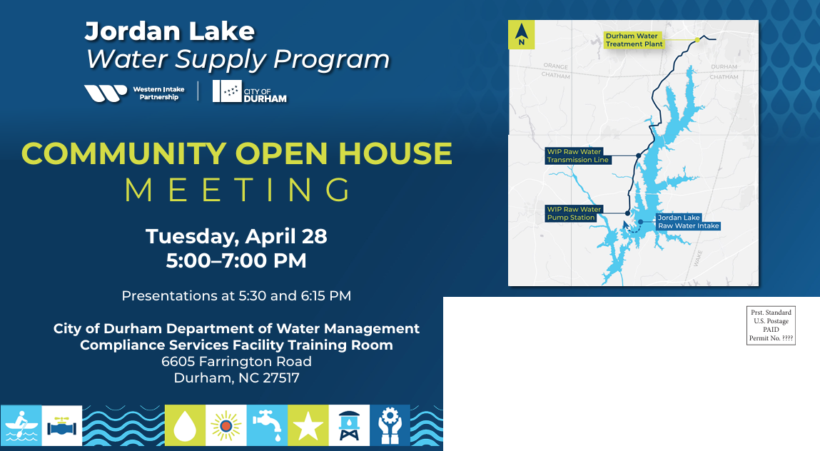
Welcome!
We’re glad you’re here
Primarily open house format, with some information to highlight in a presentation format
Please sign in if you did not already
Sign up for our newsletter and emails!
Q&A time
Same presentation at 5:30 & 6:15
Notes:
Inga for this slide then Jeff will begin with the next.

Slide 3
Our Approach
Identify
Our Approach
The overarching approach to addressing environmental resource concerns is to:
Identify resources with the potential for impact,
Avoid disturbance of resources wherever feasible,
Minimize disturbance when resource impacts cannot be avoided, and
Mitigate for unavoidable impacts.
The City of Durham strives to continue providing reliable, high-quality drinking water to its customers.
The City’s Core Values for the Jordan Lake Water Supply Program are ...
Avoid
Quality
Sustainability
Minimize
Transparency
Equity
Public Engagement
Partnership
Mitigate

Slide 4
Program Schedule
Planning & Permitting
2020-2025
PDB Procurements
2025
Design & Preconstruction
2025-2027
Construction &
Start-Up /Commissioning
2027-2032
WE ARE HERE

Slide 5
Water Intake and Treatment Plant
The Water Intake, Transmission Pipeline, and Treatment Plant are being designed to meet Partner needs through 2050 initially, and capable of being expanded to meet needs through 2070 and beyond.
A new raw water intake on the west side of Jordan Lake
A raw water supply pipeline and pump station to transport water from intake to treatment plant
A water
treatment plant

Slide 6
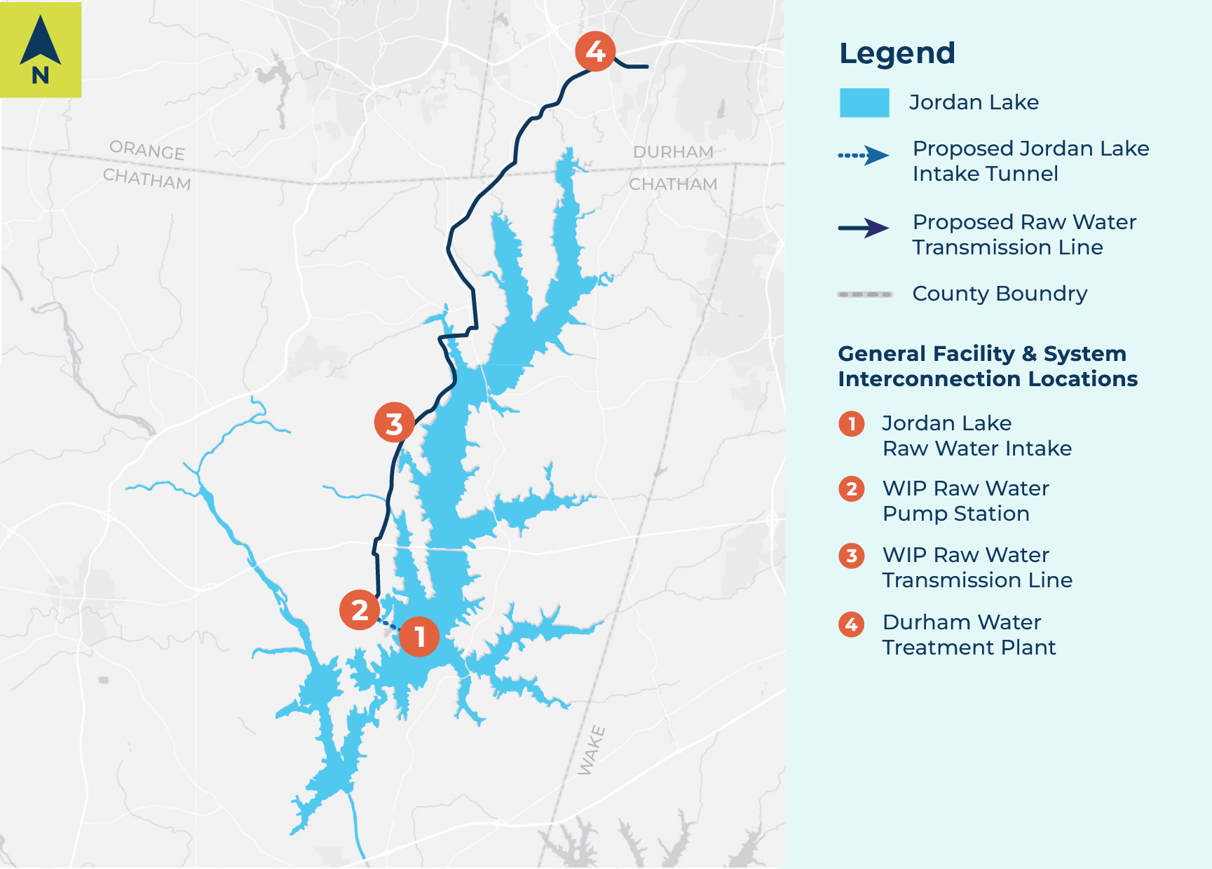
Program Updates
NEW Water Treatment Plant Location at 6903 Farrington Road
Adjacent to South Durham Water Reclamation Facility
Closer to City customers, existing City utility facilities
Opportunities for synergy & reduced costs
‘Seaforth Property’ in Chatham County, near Jordan Lake, will continue to be site for the WIP Raw Water Pump Station
Design-Build teams selected for Intake/Raw Water Facilities & Water Treatment Plant projects – designs beginning soon
US Army Corps of Engineers ‘Outgrant’ application process

Slide 7

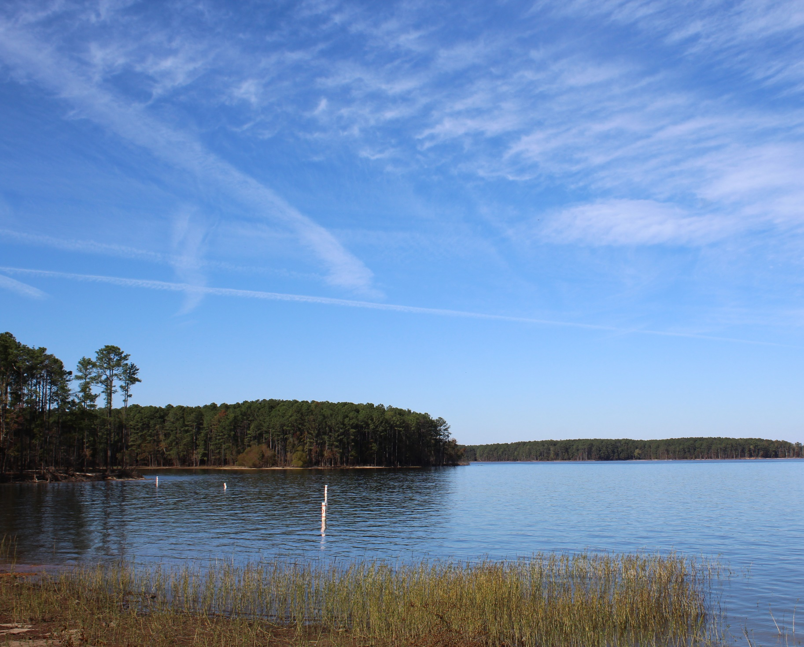
Raw Water Intake and Pump Station

Slide 8
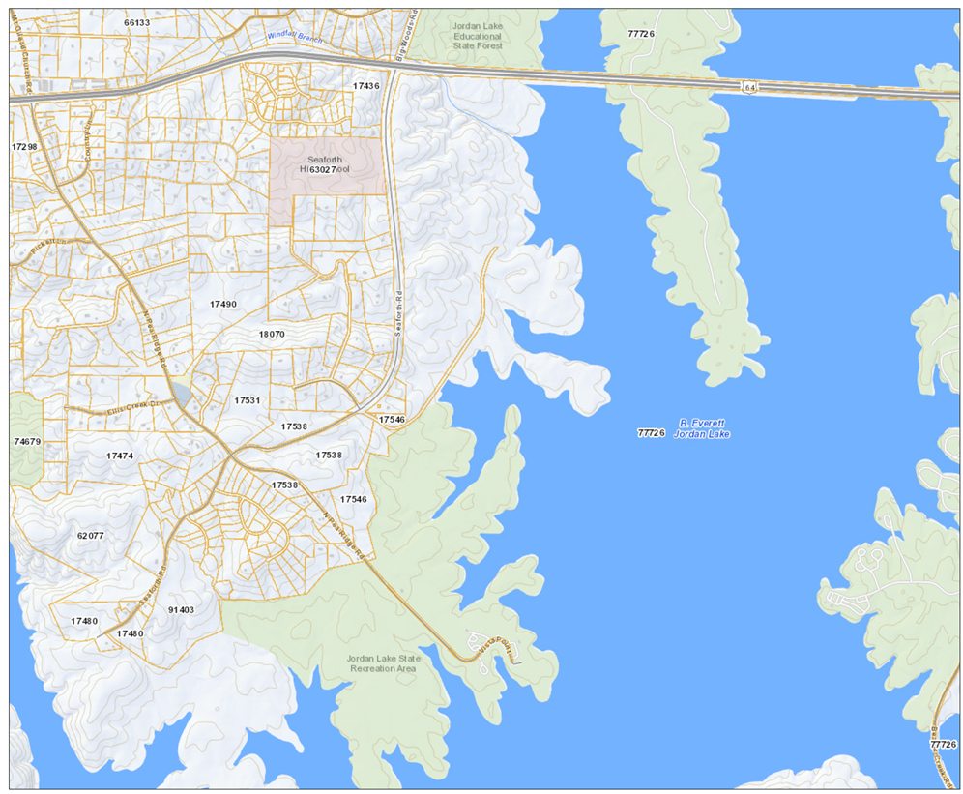
Raw Water Intake and Pump Station

Slide 9
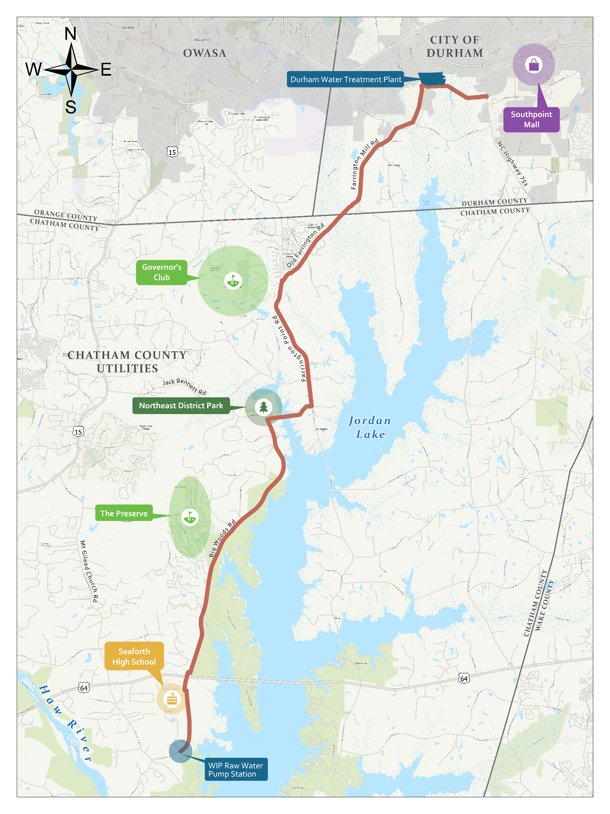
Transmission Main Alignment

Slide 10
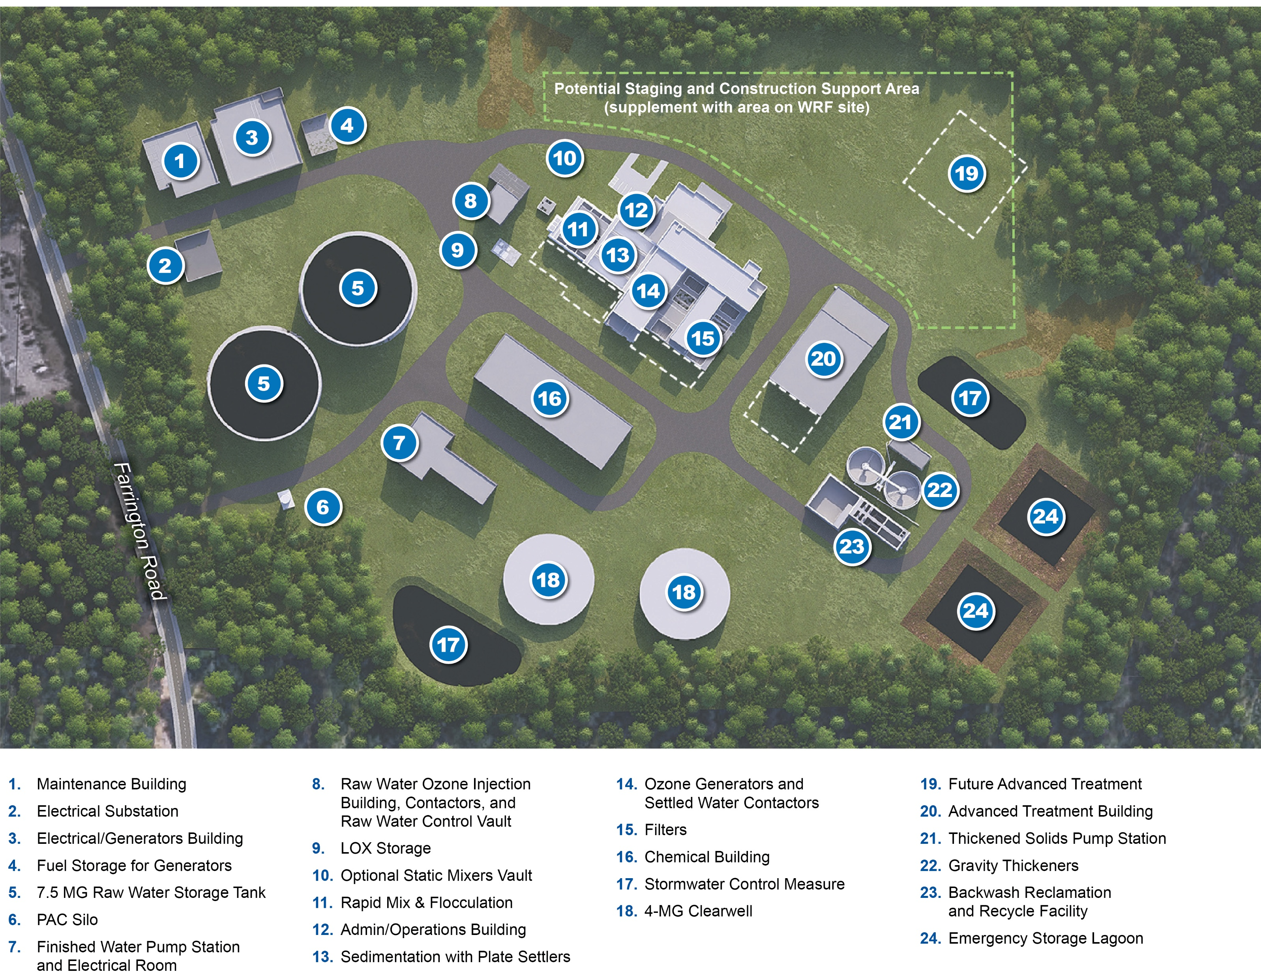
WTP Preliminary Rendering
Preliminary Concept only – other concepts being considered

Slide 11
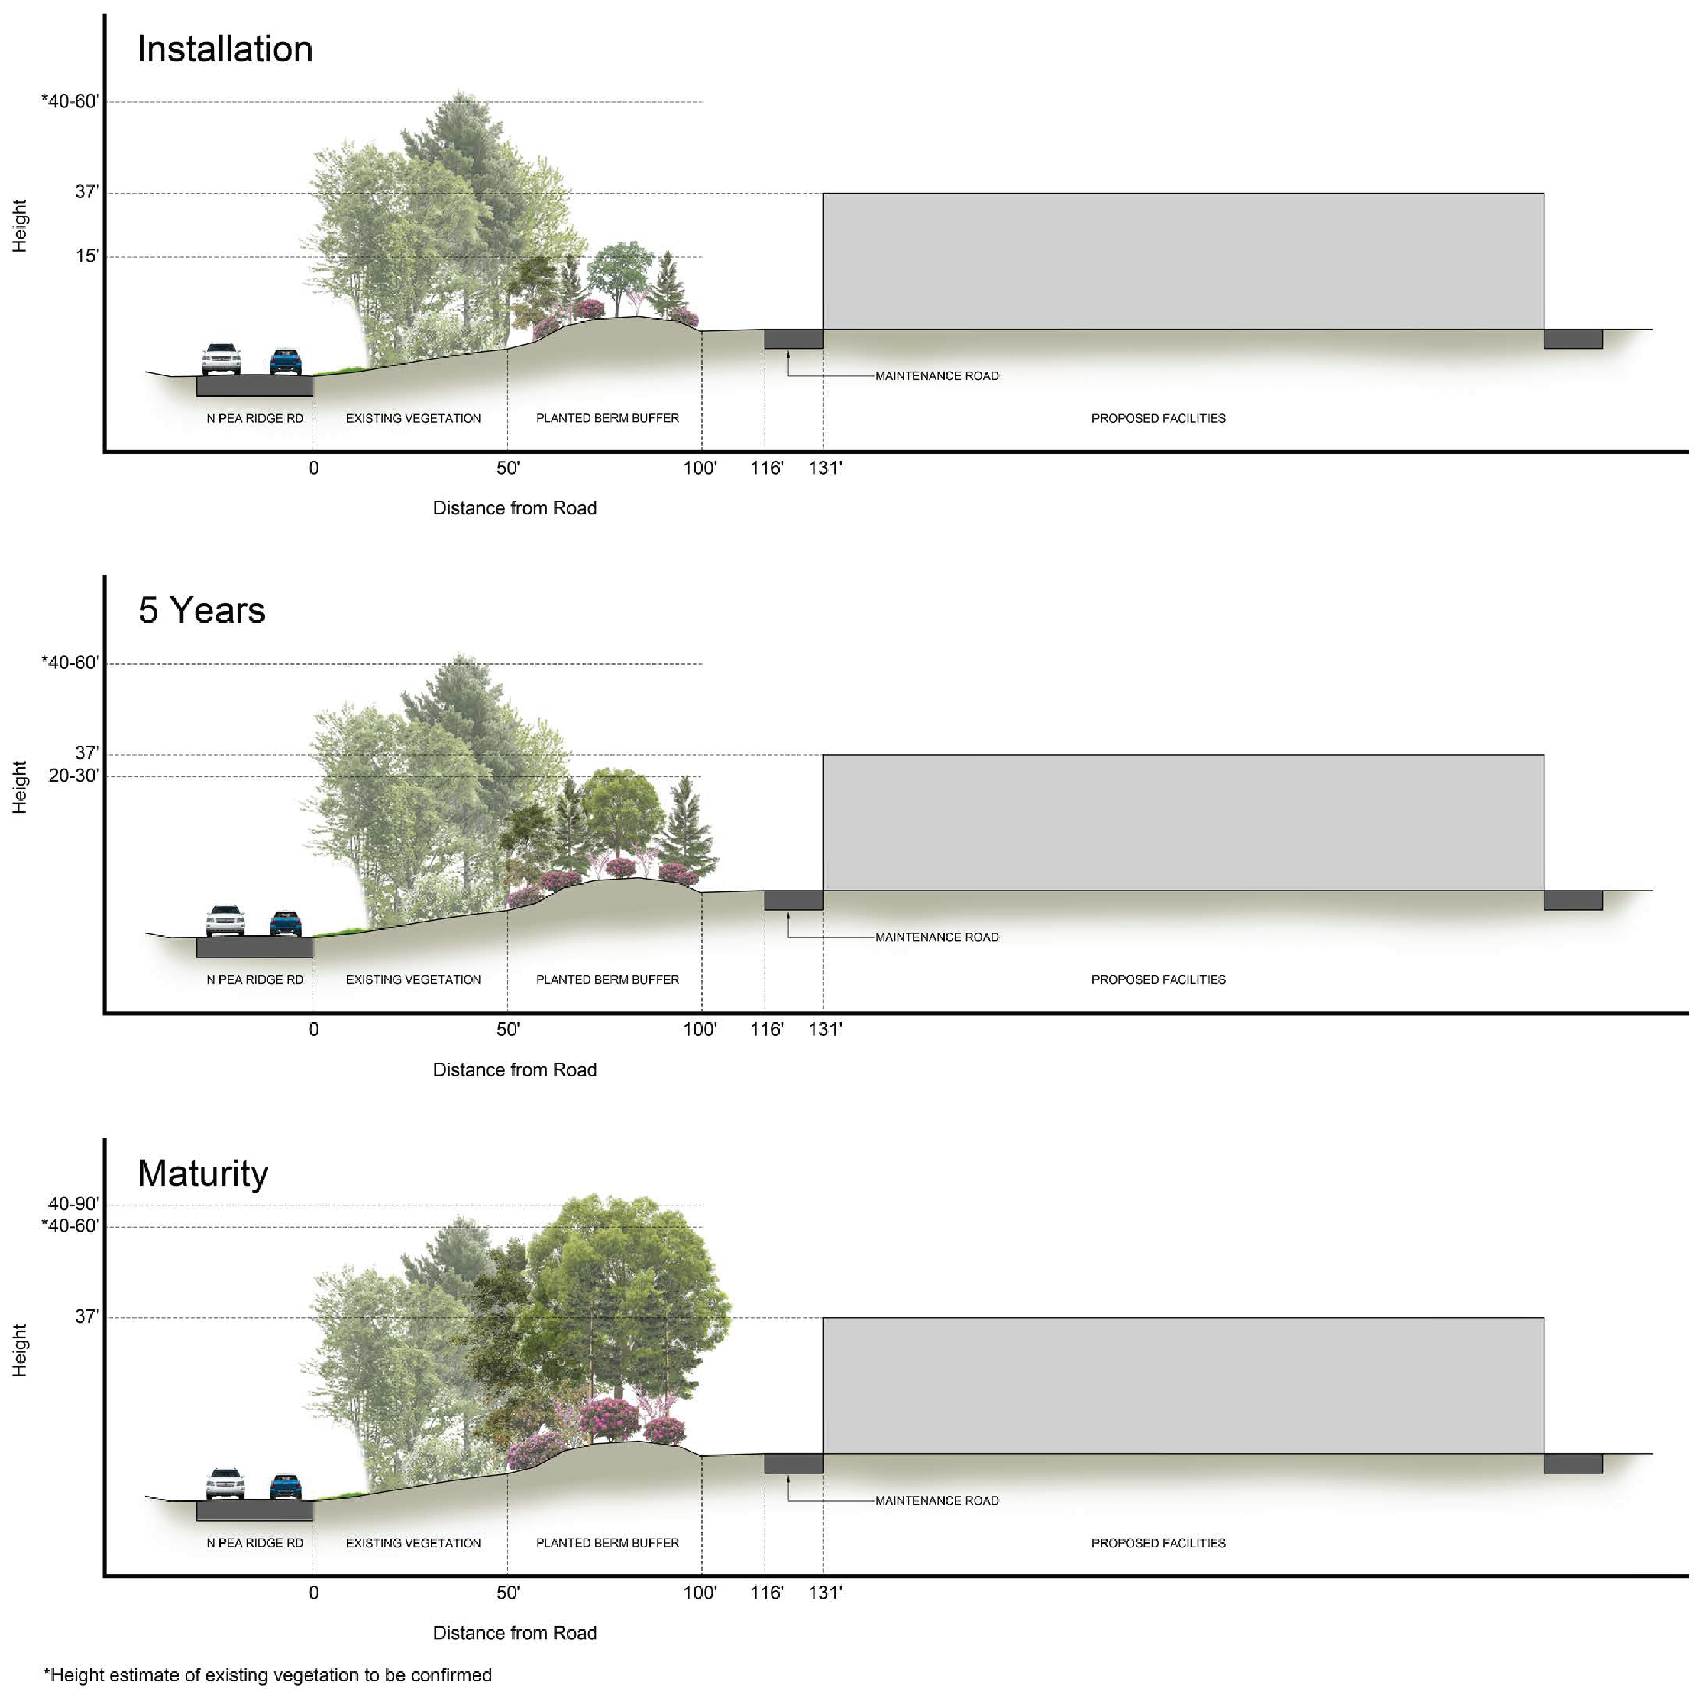
Water Treatment Plant
Will include structures and basins for water treatment process, as well as:
Administration Building
Lighting, parking, and fencing
Maintenance Building
Electrical building and generators
for backup power
Vegetation Buffer Plans
The design will seek to minimize impacts on neighbors & will maintain/enhance vegetated buffers.
Special Use Permit
City will apply to City/County Planning for a Special Use Permit, likely in late 2026 when the site plan is better defined.

Slide 12
Other Common Questions about Water Treatment Plants
Traffic
City will be coordinating with NCDOT & meet guidance / requirements
WTP Construction currently expected to start fall 2027
During construction
Most construction traffic in middle 2 years (3-4 years total)
Peak 100+ construction staff
Concrete, materials, equipment, hauling away
Transmission pipeline installation on Farrington Road
When plant is operating
Small number of employees – ~10-20
Deliveries, service vehicles infrequent (weekday, daytime)
Noise
Vegetated buffers help mitigate off-site noise
Specified dB limits on equipment that creates significant noise (ex: pump motors)
Pumps and emergency generators placed in buildings designed with sound attenuation
Noise study during design
Vibration during construction or operation – there will be measurements and notifications as needed during construction
Lighting
Design to use fixtures that limit up-lighting to the sky
Energy-efficient LED, sodium fixtures (warm color)
Provide only the necessary amount of lighting; use motion sensors, timers
Will comply with County ordinances on lighting

Slide 13
Community Commitment
City is committed to being good neighbor
  Sessions like today are part of how we live out the values of…
  Quality, Sustainability, Transparency, Equity, Partnership
City wants to hear constructive ideas for building long-term, “good-neighbor” relationship
Notes:
Transition back to Jeff for this slide and next.

Slide 14
Communications
How to Submit a Comment
  Submit a comment on the website JordanLakeWaterSupply.com using the online comment form.
  Submit your comments in person today at our Community Open House.
  Mail a letter to
  555 Fayetteville Street, Ste 900,
  Raleigh, NC 27601.
You can sign up to join our stakeholder email list and receive quarterly newsletter updates on the project website: JordanLakeWaterSupply.com
Comments will be accepted through the project design phase. As the project progresses, additional public meeting opportunities will be available.

Slide 16
Raw Water Intake and Pump Station

Slide 17
Common Questions about Intake/Raw Water Facilities project
Schedule
Construction currently expected to start winter 2027 – centered in 2 areas
Water Pump Station site Vista Point Recreation Area
Tunnel Shaft (2027)
Tunnel (2027-2028) Lake Intake (2028-2029)
Pump Station (2028-2031)
Commissioning/Startup – Both Sites (2031-2032)
Traffic
During construction
Vista Point Recreation Area to be temporarily closed during Lake Intake construction, and area used for contractor’s staging.
Peak 50-100 construction staff
Concrete, materials, equipment, hauling away
Once Intake & Pump Station are operating
Limited number of staff – remote monitoring with regular checks; Intake not occupied
Deliveries, service vehicles infrequent (weekday, daytime)
Noise
Vegetated buffers help mitigate off-site noise
Specified dB limits on equipment that creates significant noise (ex: pump motors)
Pumps and emergency generators placed in buildings designed with sound attenuation
Noise study during design
Vibration during construction or operation – will be measurements, notifications as needed during construction
Lighting
Vegetated buffers help mitigate off-site noise
Design to use fixtures that limit up-lighting to the sky
Energy-efficient LED, sodium fixtures (warm color)
Provide only the necessary amount of lighting; use motion sensors, timers
Will comply with County ordinances on lighting

Slide 18
Transmission Main Construction
Construction will be in cleared corridors or adjacent to the right of way.
Restoration and temporary driveway repair will occur following pipe installation.
Easement width and location will vary along the pipe route.
After construction, the corridor is stabilized and grass is allowed to grow.

Slide 19
What’s included in a typical water plant?
Employee & visitor parking
Administration offices
Laboratory
Maintenance shop
Electrical power supply
Emergency generators
Storage tanks (untreated & treated water)
Treatment basins & facilities
Chemicals to treat the water
Disinfection process
Treated water (“finished water”) pump station
Facility to thicken, store & haul away solids/sediments from treatment process
Roads, stormwater management
Space for future expansion
~10-20 employees typical
  Plant tours for student groups are common
2 entrances
Fencing & gates
Physical security (CCTV cameras, key-card access for gates & buildings)
Notes:
Transition to Bill. Do not need to read the list – this is just list of what would be at a WTP.

Slide 20
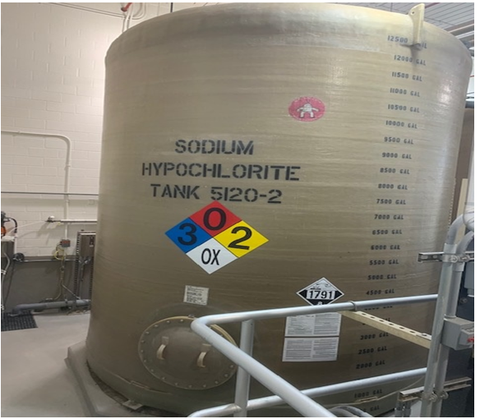
Chemicals and Odors
Preliminary list of chemicals:
    Coagulant (such as alum or ferric sulfate)
    Caustic and/or lime
    Polymer
    Sodium Hypochlorite for disinfection
    Fluoride
    Corrosion Inhibitor
    Ozone
    Permanganate
    Aqua Ammonia
    Calcium thiosulfate or bisulfite (for dechlorination)
Chemicals will be stored in accordance with City, County and State Building Codes
All chemicals will be liquid (except ozone, which is generated as needed, and possibly also a dry polymer) and stored in tanks in a building as in the photo
Most chemicals will be over 6,000 gallons stored so that chemicals can be purchased in truckloads so less trucking required
No detectable odors are expected offsite
Notes:
There will be no chlorine gas used or stored at the site.

Slide 21
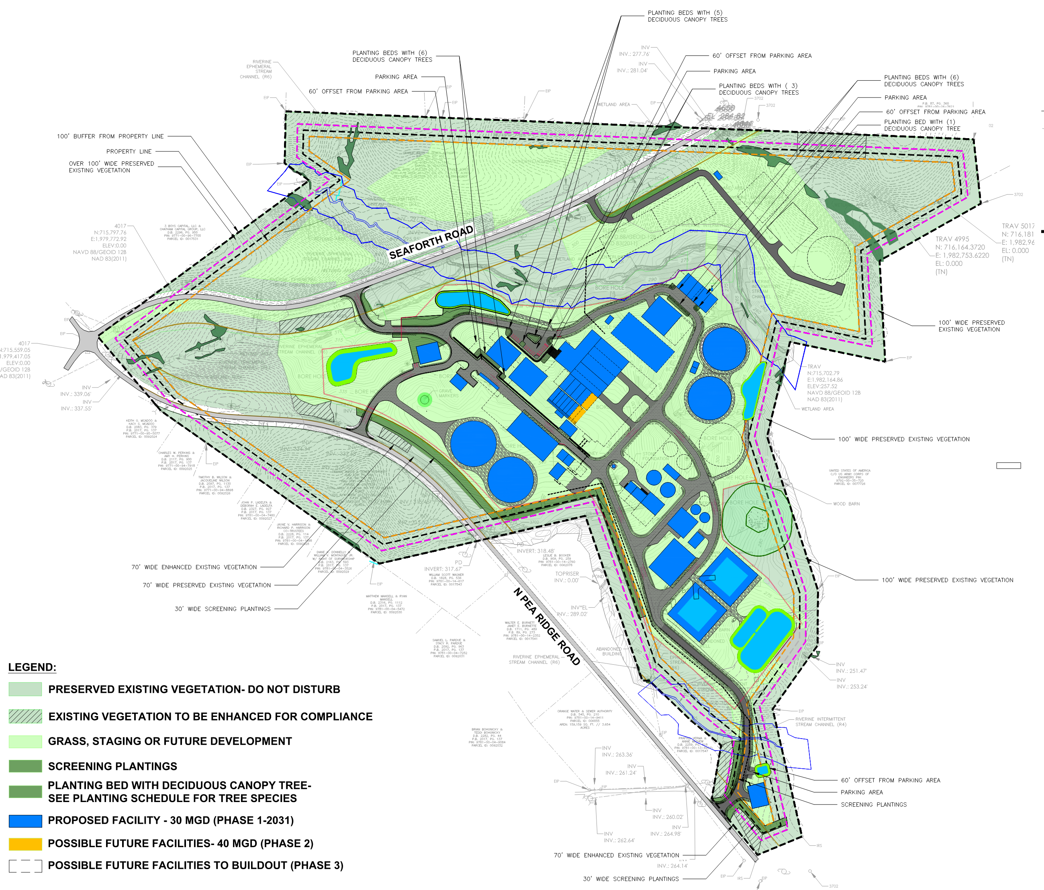
Preliminary Site Plan/Landscape Plan

Slide 22
Key Environmental Findings
Key findings from the environmental assessment include:
  No potential Environmental Justice concerns have been identified
  WIP will continue to gather community information and communicate with the public on its plans
  The JLWSP will satisfy important public supply water needs through 2070 and beyond
  Recreational uses at Vista Point Recreation Access Area to be suspended during part of the JLWSP construction period
  City of Durham is working with NC Parks to mitigate the temporary closure of this facility for ~ 3 years
  Placement of intake tower in Jordan Lake could pose potential safety concerns for boaters
  City of Durham is working with NC Wildlife Resource Commission to mitigate any concerns

Slide 23
Key Environmental Findings
Key findings from the environmental assessment include:
  Little or no significant impact for most environmental resources
  No impacts to historic or archaeological features, with concurrence from the NC State Historic Preservation Office
  Most disturbances to wetlands, streams and surface waters will be temporary, and permanent impacts will be restricted to small areas
  No significant impacts to fish and aquatic wildlife
  No significant impacts to air quality, climate, floodplains, groundwater, wildlife, land use, traffic, hazardous materials
  Unavoidable loss of trees at the Pump Station site and Treatment Plant site, and along the transmission pipeline to Durham
  Pump Station Facility and Treatment Facility will have permanent forested buffer on all sides
  Pipeline corridor managed to control nuisance vegetation and trees will be allowed to regrow
  in parts of the corridor

